Slide 1
RISK MANAGEMENT & INTERNAL AUDIT-I
Three Lines of Cyber Defense:
https://securityintelligence.com/take-a-load-off-delegate-cyber-risk-management-using-the-three-lines-of-defense-model/

Slide 2
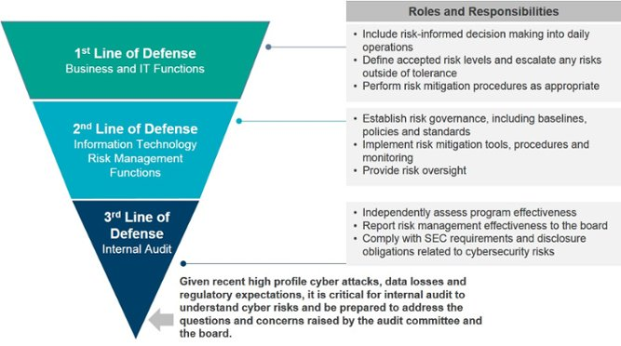
RISK MANAGEMENT & INTERNAL AUDIT-I
https://info.knowledgeleader.com/what-is-internal-audits-role-in-cyber-security

Slide 3
RISK MANAGEMENT & INTERNAL AUDIT-I
1. Business & IT Functions (Management Control):
The first line encompasses the information security department as well as various business units that own their cyber risks. These entities need to understand how their assets are vulnerable and actively manage their cyber risks within…

Slide 4
RISK MANAGEMENT & INTERNAL AUDIT-I
1. Business & IT Functions (Management Control):
…organizationally acceptable tolerances. Sometimes called management control, this function is tasked with managing cyber risks by executing various controls. This means handling risk events, updating key risk indicators (KRIs), and…

Slide 5
RISK MANAGEMENT & INTERNAL AUDIT-I
1. Business & IT Functions (Management Control):
…deploying and managing controls that affect people, processes and technology.

Slide 6
RISK MANAGEMENT & INTERNAL AUDIT-I
2. Risk Management
The second line of defense is composed of risk managers looking at aggregate risks at an enterprise level. It is often simply termed risk management but can also include compliance, legal, quality control and financial control.

Slide 7
RISK MANAGEMENT & INTERNAL AUDIT-I
2. Risk Management
The second line looks at cybersecurity control frameworks, defines KRIs and metrics, creates risk assessments, and tests and reviews conformance by tracking the actions of the first line of defense and analyzing the…

Slide 8
RISK MANAGEMENT & INTERNAL AUDIT-I
2. Risk Management
…impact of those actions to determine their effectiveness in mitigating cyber risks. In other words, this function monitors how management is doing in its handling of cyber risks by determining the extent that risks are actively monitored and appropriately managed.

Slide 9
RISK MANAGEMENT & INTERNAL AUDIT-I
2. Risk Management
It is often performed under an umbrella of senior management and some board directors or a board-level committee, such as the audit committee or a risk committee. And, importantly, this second line can challenge the first line.

Slide 10
RISK MANAGEMENT & INTERNAL AUDIT-I
ISSUES WITH RISK MANAGEMENT IN PAKISTAN
Risk Management hierarchy not trained in IT
Separate Dept – not suitable given security maturity level
Seen as outsider
Low cooperation levels with IT
END

